Slide 1
CONTROL TESTING :IT SOX 404 COMPLIANCE
BY CA.SOMDEB BHATTACHARYA
Somdeb2010@yahoo.co.in /9739063820

Slide 2
AGENDA
What is SOX and SOX History
Financial SOX
Different SOX Provisions
IT SOX 404
IT SOX GRC
Different IT SOX 404 Controls
IT SOX 404 under SAP system environment
Sample Templates of ToD,ToE and RCA
Relevance of SOX Compliance with recent cases
Present issues with IT SOX Compliance
Opportunities for CA in SOX Compliance

Slide 3
What is SOX
What is SOX:
SOX provides the foundation for new corporate governance rules, regulations & standards issued by the Securities and Exchange Commission in US. It covers a range of topics from criminal penalties to Corporate Board responsibilities.
SOX covers such as independent auditing requirements ,corporate governance ,internal control assessment and enhanced financial disclosures.
CEO of publicly traded companies will be held accountable for the quality of the controls established which enable accurate financial reporting (including IT processes, system &roles)
The primary thing to remember about SOX is about mitigating the risk of fraud, financial transparency and process control.
SOX History:
The SOX Act came into force in July30,2002.The act was required to mitigate risk caused due to major accounting and corporate governance issues.
The SOX Act is named after U.S Senator Paul Sarbanes and Representatives Michael Oxley
The Sarbanes Oxley Act also led to the creation of yet another organization Public Company Accounting Oversight Board (PCAOB),which is charged with overseeing the accounting firms that audit publicly traded businesses.
The SOX Act is arranged into eleven titles. The Act was enacted as a reason to several major corporate and accounting scandals. The following are top ten financial scandals (a)Waste Management,1998 (b) ENRON,2001 ( c) WorldCom,2002 (d) TYCO,2002 (e) HealthSouth 2003 (f) Freddie Mac,2003 (g)AIG,2005 (h)Lehman Brothers,2008 (i)Bernie Madoff,2008 (j)Satyam 2009.
In case of Enron was revealed that Enron’s reported financial condition was sustained by an institutionalized ,systemic and creatively planned accounting fraud.
The primary thing to remember about SOX is about mitigating the risk of fraud, financial transparency and process control

Slide 4
Financial SOX
SOX 404 are based on the following areas:-
(a)Fixed assets (b) Procure to Pay ( c) Entity Level Controls (d)Treasury Management (e ) Order to receivable (f) Record to Report (g)Inventory Management (h)Duties and Taxes (i)Payroll & Hire Retire.
At the initial stage ,SOP/Playbook will be requested from the business process owners.
We will start with Test of Design (ToD) for all above business processes as per SOP shared with us .
At Design Phase (a)Conduct Walkthrough (b)Design and Implementation evaluation ( c) Identify design gap if any.
Once TOD is passed then we will move to Test of Operating Effectiveness(TOE)
We will share remediation steps to follow for all deficiencies observed during TOE
Next step is recording, or documentation based on IPE/testing evidences from the business process owner to decide whether the said process effective or in-effective.
Finally, we will report to the management mentioning risk level and remediation steps to follow.

Slide 5
IT SOX Provisions
Sec 302 requires :Periodic certification by CEO and CFO and mandates a set of internal procedures designed to ensure accurate financial disclosure.
Sec 303 requires: Improper influence on conduct of audits (a)Rules to Prohibit (b) No Preemption of other law ( c) Enforcement (d) Deadline for rulemaking .
Sec 401 requires :Disclosure in periodic reports (Off-Balance Sheet Items) An operating lease is one of the most common off-balance sheet items
Sec 404 requires :Assessment of internal controls over Financial Reporting (ICFR).
Sec 409 requires :Real Time Issuer Disclosure relating to material changes in its financial conditions or operations .
Sec 806 requires :Protection for employees of Publicly Traded Companies who provide evidence of fraud (Sarbanes Oxley Whistleblower)
Sec 902 requires: Attempts & conspiracies to commit Fraud Offences
Sec 906 requires: Corporate Responsibility for Financial Reports

Slide 6
IT SOX 404
IT SOX 404 :-
Sec 404 requires assessment of internal control over Financial Reporting (ICFR)
It is known as SOX 404 top-down risk assessment where both external auditor and management of the US Publicly Listed Companies under Security Exchange Commission (SEC) to report on adequacy of the company’s internal control over financial reporting (ICFR).The auditor also focus on entity level controls and works down to significant account disclosure and their relevant assertions .
Main controls are (a)Entity Level Controls (b) IT Application Controls ( c) IT General Controls
(a) Entity Level Controls : (i) Risk assessment activities (ii) Strategies and Plans (iii) Policies and Procedures (iv) Training and Education (v) Quality Assurance (vi) Internal Audit.
(b) IT Application Controls : (i) Completeness (ii) Accuracy (iii) Existence /Authorizations (iv) Presentation/Disclosures , we are using C&A Template (Completeness and Accuracy) plus use of programming language as per the applications applicability.
( c) IT General Controls : (i) Program Development (ii) Program Changes (iii) Access to Programs and Data (iv) Computer Operations
IT. SOX 404 controls are based on (a) Accuracy (b) Security ( c) Change Management ( d) Backup procedures

Slide 7
IT SOX GRC
IT SOX GRC :-
Governance:-
Control Universe :All ITGC Controls
404 Application Listing (for e.g. those business applications supporting various servers &DB like for example Blackline apps)
Meeting with the client quarterly testing schedule as a SME (Subject Matter Expert)
Weekly Reporting
Accountability and Ownership
Meeting Compliance
(b) Risk Management
Maintaining Risk Register
Maintaining RACI (Responsible,Accoutable,Consulted and informed ) Matrix for IT SOX Compliance Work
Sampling selection based on risk level, risk assessment ,risk response and IT risk mitigation steps and follow-up
( c) Compliance
Provide oversight to stated controls. Perform both ToD & ToE of IT SOX Controls ,IT Compliance Activities in relation to IT SOX process automation application platform, providing IT Compliance approvals for those change management process affecting IT Security Baseline .
Provide reasonable assurance that environments are secure and protected using various tools like SNOW,RSA Archer, Oracle and SAP control using documentation tools.
RCA (Root Cause Analysis) RCA is required for failed controls
Exception testing /analysis required for control that passed SOX testing but did not meet all client SOX requirements, for example password reset under Cyber Ark.
External Auditor requests or internal audit requests.

Slide 8
Different IT SOX Controls
Physical Control at data center here mainly reconciliation of manual register vs access log reports
Development Level Testing :Mainly here related to checking approvals and sign off process as per SOP
Change Application Controls
Ensure System Security: Account Management(UAM)
Managing Data Backups
Password Management (a) password policy (b) Unique User identification ( c) Default vendor related applications
Access to Production :SoD
Security Baseline (Minimum Security Standard fulfillments):Administrative Authority (PUAR) & Log Review of different OS (Wintel,AIX,Teradata ,Backup), DB (Oracle ,SQL)
Problem Management
NEPW :Non Expiry Password
PUAR review:Priviileged User Access Review done on quarterly/half-yearly basis.
Quarterly/Half-yearly :Resource Owner Review

Slide 9
IT SOX 404 under SAP Environment
There are SAP process document available for each SAP system: ECC(PR3),HANA (S4P),BPC ICON(b4p),FIORI(PSF),GRC.12(GRP)
Detailed testing steps using T-code and table name, other detailed steps of user type, user group and period covered to execute the report
We need one independent check and then receive one or two samples from SAP ERP Security team for each month for business testing results along with incident ticket(SNOW ticket) in support of it.
We need to document under TOD & TOE template, screenshot of independent check with date & time stamp for each steps followed for TOD & TOE plus attach business testing screenshots as per SNOW ticket.
For a few SAP controls , substantive testing may be required if an interactive account logged into SAP system other than allowed generic IDs. We may need to further log review of those cases for further investigation for the reason of the access and whether prior approval is taken or not.
We may also find cases where due to wrong account classification other than generic accounts covered from dialog or service may be covered so in those cases SAP Security team will rectify those findings.
We need to follow non-SAP Control RSA documentation in addition to it.

Slide 10
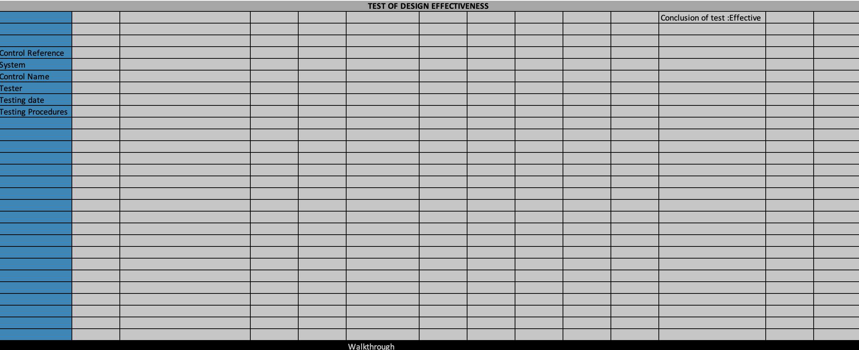
Testing Template (ToD,ToE &RCA)

Slide 11
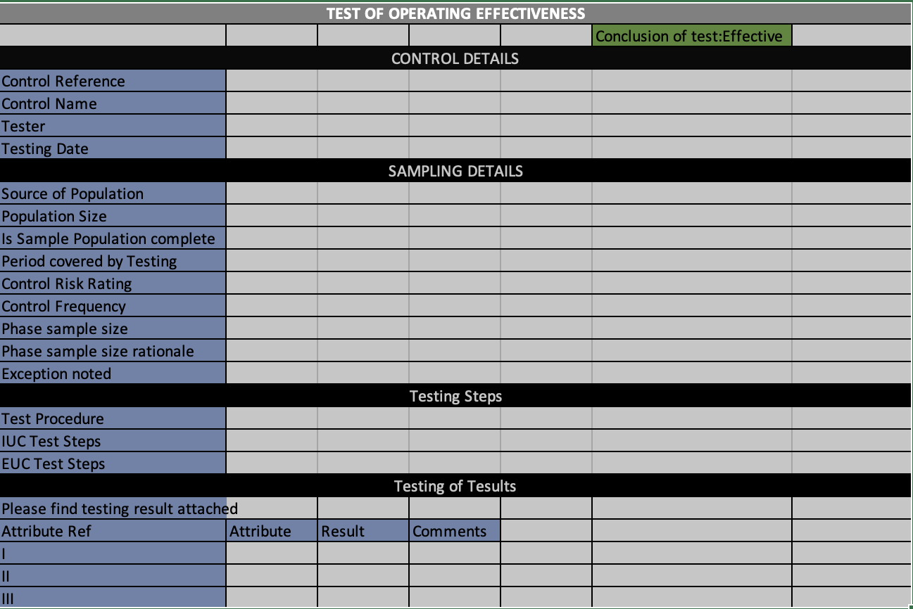
Testing Template (ToD,ToE &RCA)

Slide 12
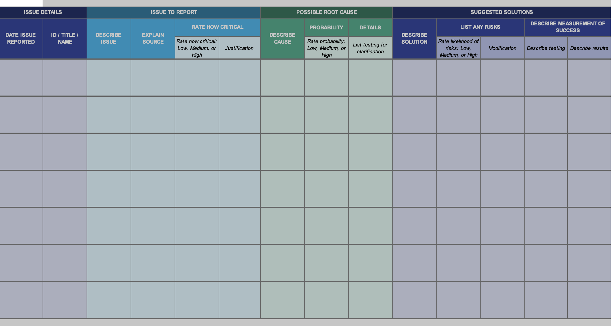
Testing Template (ToD,ToE &RCA)

Slide 13
Relevance of SOX Compliance with recent cases
While the debate rages on about the expenses involved in SOX compliance and the degree of empowerment SOX provided to the SEC , i t remains clear that there is no widely accepted beneficial result SOX has provided
The debate continue how to manage SOX requirements and what changes might make the law more effective
With the 20th anniversary of the law (i.e. GDPR ,CCPA) new consideration is underway regarding how it can provide insights into protecting the public in the spirit in which the law was created .
It seems that fraud and conspiracy are all around us. Buzz words such as “misinformation” and “disinformation” haunt the daily news, and the trust seems to establish.
Unfortunately , just a quick web search highlights several recent cases of fraud, including:
United States vs Epsilon Data Management LLC, (Docket number :1:21-cr-00006-RM)is a judgement approved for a deferred prosecution agreement (DPA) , on 27 January 2021, regarding Epsilon Data Management LLC knowingly selling data to clients engaged in fraud. The agreed penalty was US$150 million.
United States vs Facebook ,Inc ,(Docket Number:1:19-cv-2184(DDC) was an approved settlement between Facebook and the US Federal Trade Commission(FTC) for violations of the US Federal Trade Commission Act regarding misrepresentation of how consumers could protect personal data and misrepresentation of how Facebook used consumer personal data. A US $ 5 billion civil penalty was levied by the US District Court for the District of Columbia .Additionally, the judgment required Facebook to establish an independent assessor and independent privacy committee to oversee compliance with the judgement ,April 2020.
The environment that authors former US Senator Paul Sarbanes and former US Representative Michael Oxley addressed with SOX does not look into the world we live in today, especially regarding technology ,which continues to impact our lives at a frenetic pace. It is the challenge all lawmakers and practitioners face: How to adopt an “old” law to the new world.

Slide 14
Present issues with IT SOX Compliance
SOX benefits derive from the belief that regulation is necessary to promote and enforce good behavior. As auditor and risk management professionals , the balance of appropriate requirements is key. One might even suggest that appropriate guidelines ,whether regulatory or basic –in-house governance is the rallying for the audit profession. The following key factors are worth consideration :
Impact of technology on record retention : use of automation like ETL(Extract Transform and Load) process
In line with auditing tools that verify system integrity : there are lots of audit tools we need to upgrade
The concept of monitoring controls , instead of only preventive or detective controls : Here we are focusing on continuous improvement.
Finally, risk assessment and audit discipline are keys to benefit from legislative efforts such as SOX.

Slide 15
Opportunities for CA in SOX Compliance
The following are opportunities for CA in SOX Compliance :-
Anyone doing IFC audit where we are covering internal control over financial reporting can easily move to SOX 404Compliance field .
A practicing CA having additional certificates like CPA (Certified Public Accountant) can also look for work on that field from an external auditor point of view.
For IT SOX 404 , we need to have some knowledge of ITGC /IT Security topics like CIA (Confidentiality , Integrity and Availability)
A person with DISA certificate background also can move to IT SOX 404 compliance field.

Slide 16
Questions

